Slide 1
CHE507 Homework #3
Due 11/14

Slide 2
Consider the following The jacketed CSTR as demonstrated in the previous homework
W, Tf, Cf
Set Point
TRC
FC
A → B
T_{c}
Tc, W_{c,}
T, C_{a}

Slide 3
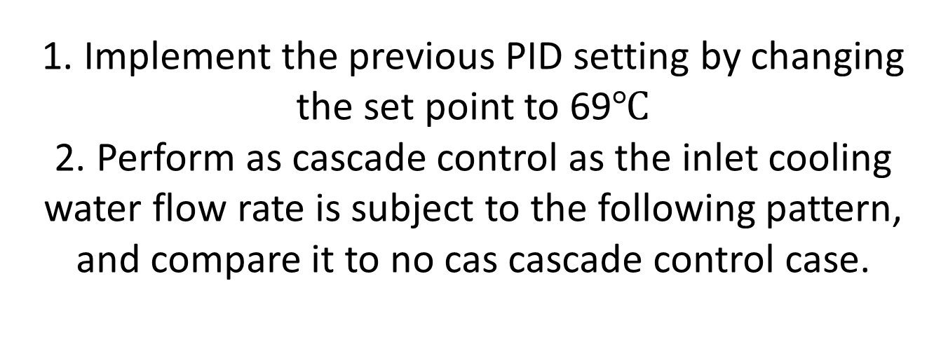
1. Implement the previous PID setting by changing the set point to 69$℃$ 2. Perform as cascade control as the inlet cooling water flow rate is subject to the following pattern, and compare it to no cas cascade control case.

